Slide 1
The Mission of the Church in a post-Covid society
Raymond Friel
CEO, Caritas Social Action Network
Twitter: @friel_raymond
ATCRE Conference Workshop, 2 October 2021
“The Lord your God is with you wherever you go” (Joshua 1:9)
Notes:
“The joys and hopes and the sorrows and anxieties of people today, especially the of those who are poor and afflicted, are also the joys and hopes, sorrows and anxieties of the disciples of Christ, and there is nothing truly human which does not also affect them.”
Gaudium et Spes, 1
Someone once said the Church provides compelling answers to questions nobody is asking….I think that changed in Covid…

Slide 2
Being truly human
“The joys and hopes and the sorrows and anxieties of people today, especially of those who are poor and afflicted, are also the joys and hopes, sorrows and anxieties of the disciples of Christ, and there is nothing truly human which does not also affect them.”
Gaudium et Spes, 1

Slide 3
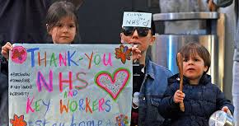
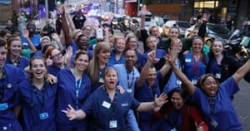
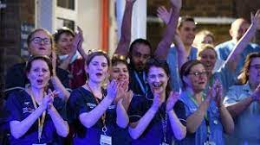
Lockdown 2020:
What did we remember about being truly human?
Gratitude – social liturgy
Sacrifice – self-offering
Workers - visibility
Courtesy – I hope you’re well
Community – the common good
Charity – giving, volunteering
Vulnerability – the shielding
Mortality – momento mori
Simplicity – do with less
Prayer – Help me, Lord
Presence – real presence
Creation – clean rivers, empty skies
“An eruption of fraternity” – Pope Francis
Notes:
Remembering about being human – Conscience Spirit at work within us - community torn at in last 40 years neoliberal economics – this is our language – someone once said that the Church provides compelling answers for questions which no one is asking….an eruption of fraternity…almost medieval….in the furrows dug by suffering new language of faith and new paths are flourishing….p10 PD, massification and fragmentation (p7 PD)

Slide 4
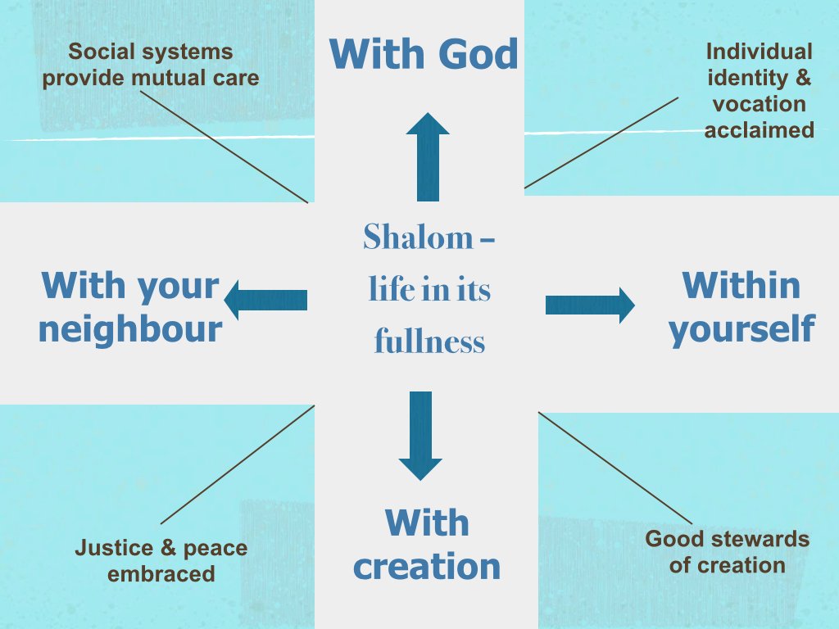
Notes:
Being fully human - When all four connect the love mercy of god flows, we are conduits of divine grace

Slide 5
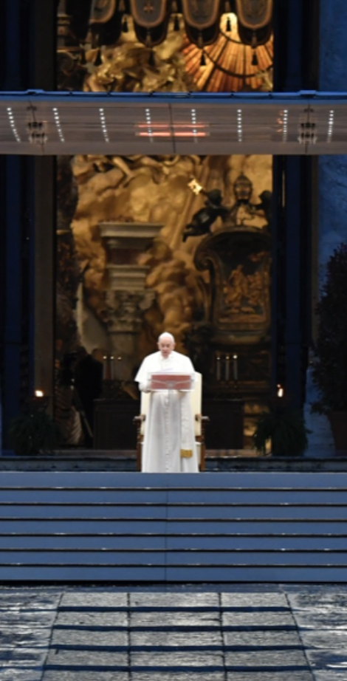
MARCH 2020
“Like the disciples in the Gospel we were caught off guard by an unexpected, turbulent storm. We have realized that we are on the same boat, all of us fragile and disoriented, but at the same time important and needed, all of us called to row together, each of us in need of comforting the other.”
Pope Francis
Notes:
Dignity, solidarity, common good….The “we” in this is the we of humanity, the Church addressing the world, one of the very few institutions that can address the world and in that moment the words of Vatican II were alive, the Gospel was alive, Christ in the sacrament blessed a suffering world…this was the Church as envisaged by John XXIII in his opening address to Vatican II, a mother, or in the wonderfully prescient image of Pope Francis from an interview well before the pandemic, a field hospital

Slide 6
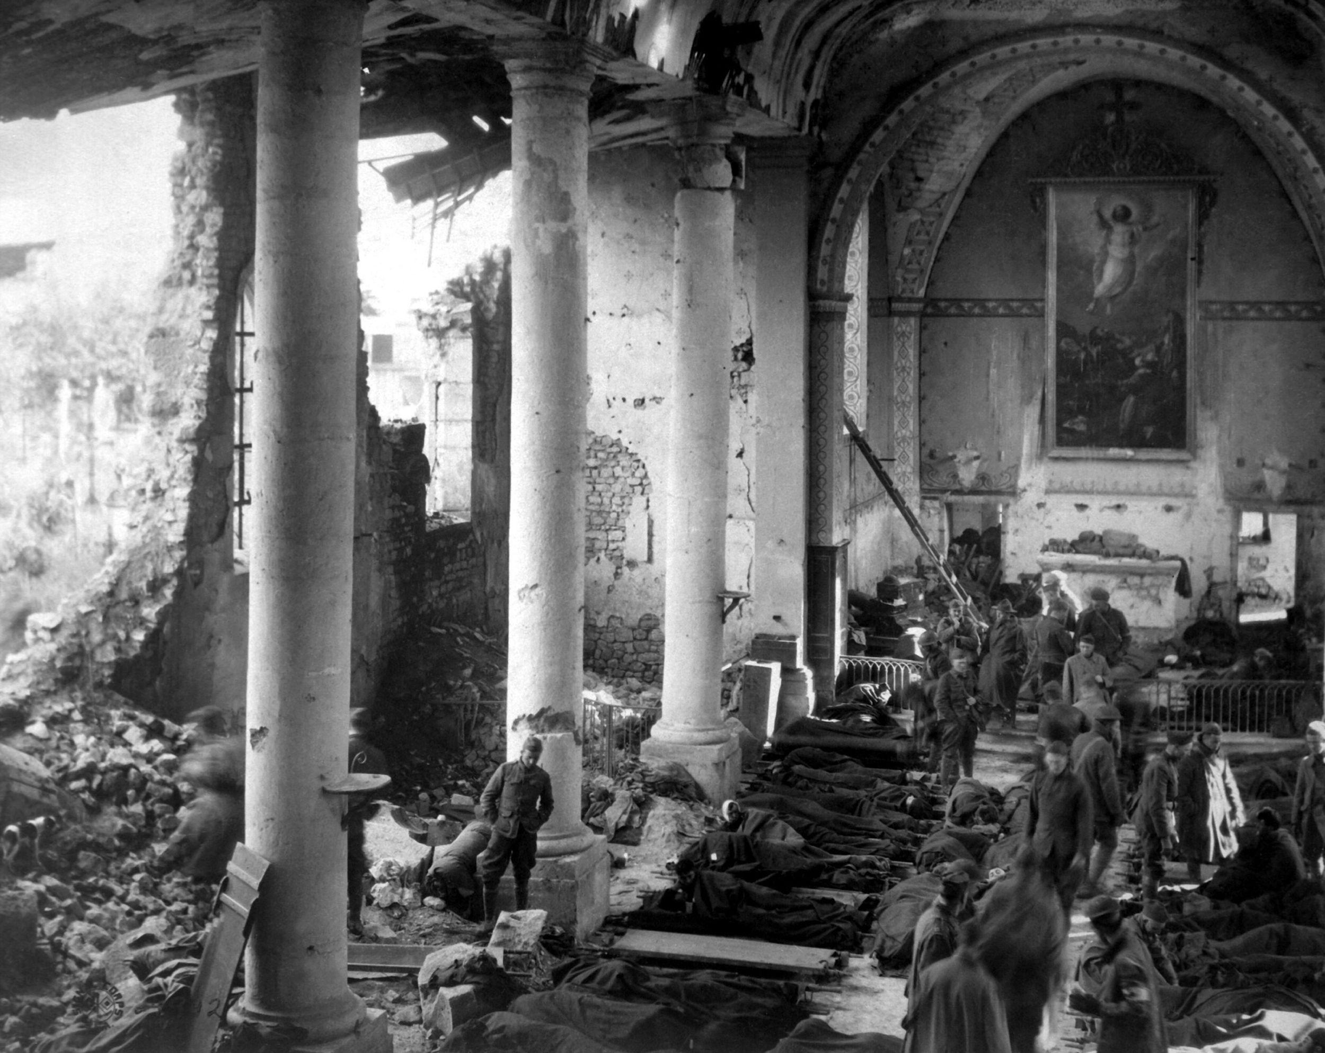
Field Hospital
“The thing the church needs most today is the ability to heal wounds and to warm the hearts of the faithful; it needs nearness, proximity. I see the church as a field hospital after battle.”
Pope Francis
Notes:
Plus Halik article….If the Catholic Church is a field hospital then I propose that the Catholic School, now more than ever, is a health centre of the human spirit…building a therapeutic community around schools, IMAGES very biblical approach which VII revived, images of Church in LG….also mustard seed and shrub that shelers the birds of the air…a generous welcoming, non-judgemental space, a sanctuary, a place of healing and restoration

Slide 7
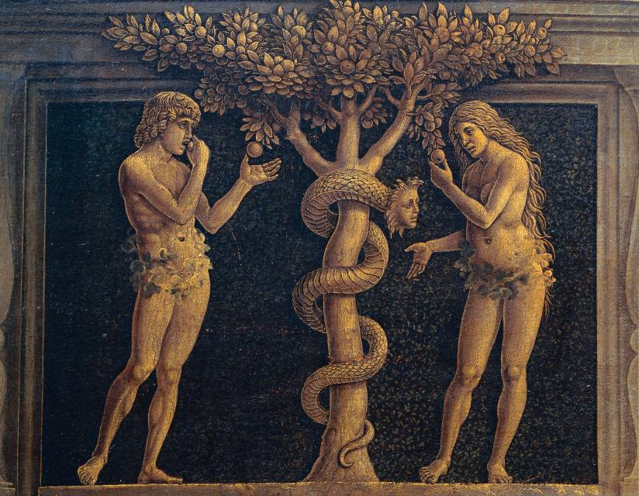
Diagnosis
“Our sin lies in failing to recognise value, in wanting to possess and exploit that which we do not value as gift. Sin always has this same root of possessiveness, of enrichment at the expense of other people and creation itself…..The sin is in exploiting that which must not be exploited, in extracting wealth (power or satisfaction) from where it should not be taken. Sin is a rejection of the limits that love requires.”
Pope Francis, Let Us Dream
Notes:
Structures of sin – JPII – On Social Concern – rooted in original and personal sin and its social consequences – desire for profit, thirst for power, power over, exploitation….sin of the world….Genesis consequences of original sin was distorted relationships…GOOD NEWS….there is another way to be human….to belong together….we can be freed from this and its consequences….Called out of darkness….justified by his as a gift…Rom 3 grace through faith, expressed in love….Romans

Slide 8

Salvation is universal and integral
“God, in Christ, redeems not only the individual person but also the social relations existing between men and women.”
Compendium of the Social Doctrine of the Church, 52
Notes:
For all people and the whole person…McCabe says that at crucifixion original sin is revealed as our rejection of God’s love, our desire to scapegoat the one who challenges our injustice, our relationships based on fear and domination, rivalry and violence, greed and power; at crucifixion sin of the world is simultaneously revealed and conquered, forgiven…“The turning point of human history, the moment when we realized what we were about, the moment when we saw that the meaning of being human was love, was the crucifixion of Jesus.” Paul VI, EN then JPII for integral salvation, also The Common Good
Herbert McCabe God Still Matters, p. 5

Slide 9
“The Church aims at a “complete form of humanism”, that is to say, at the “liberation from everything that oppresses man” and “the development of the whole man and of all men”. The Church's social doctrine indicates the path to follow for a society reconciled and in harmony through justice and love.”
Compendium, 82
Notes:
Foundation for this is the exceptional dignity of the person, made in image of God, with a vocation to be images of God on earth, to be loving…

Slide 10
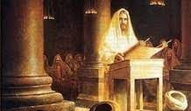
The Nazareth Manifesto
“The Spirit of the Lord is upon me, because he has anointed me
to bring good news to the poor.
He has sent me to proclaim release to the captives
and recovery of sight to the blind,
to let the oppressed go free,
to proclaim the year of the Lord’s favor.”
Luke 4: 18-19
Notes:
Proclamation, justice advocacy and compassion…..love insists on justice, completes justice, proclamation without compassion is rhetoric, or triumphalism, Cardinal Sin said justice advocacy without compassion is Marxism….

Slide 11
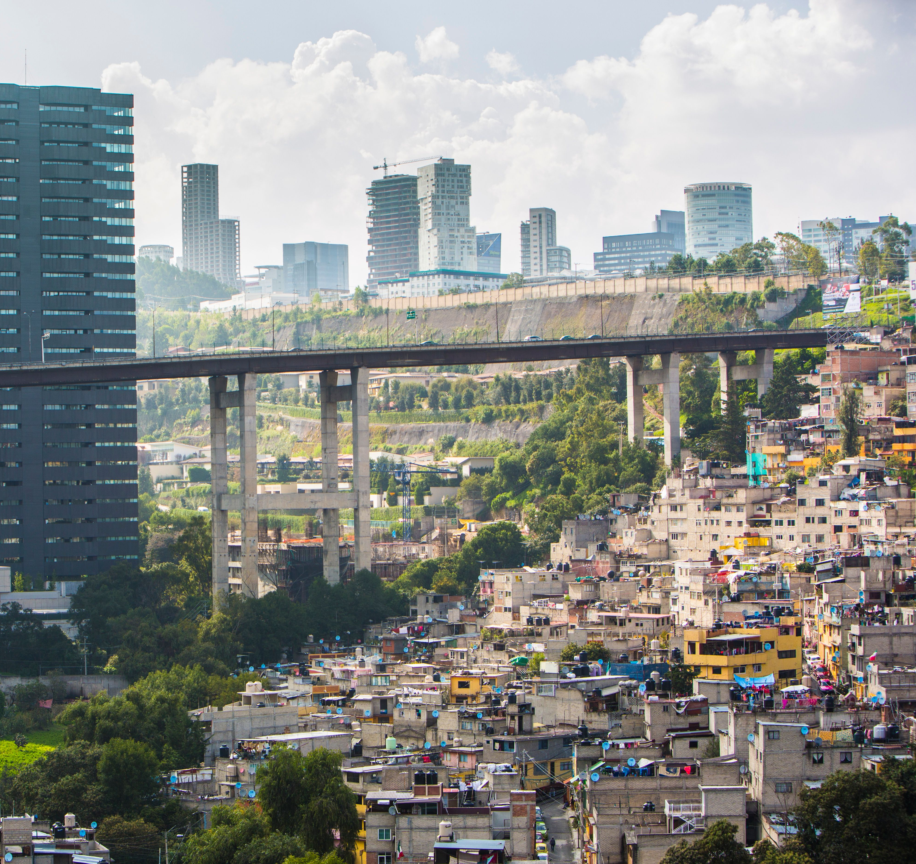
Preferential option for the poor
“Those who are oppressed by poverty are the object of a preferential love on the part of the Church which, since her origin and in spite of the failings of many of her members, has not ceased to work for their relief, defence and liberation.”
CCC, 2448
Notes:
WDOTP, forms of poverty….from less human conditions to more human conditions….Compassion – proclamation – justice advocacy….where are they – Francis – go to the margins…

Slide 12
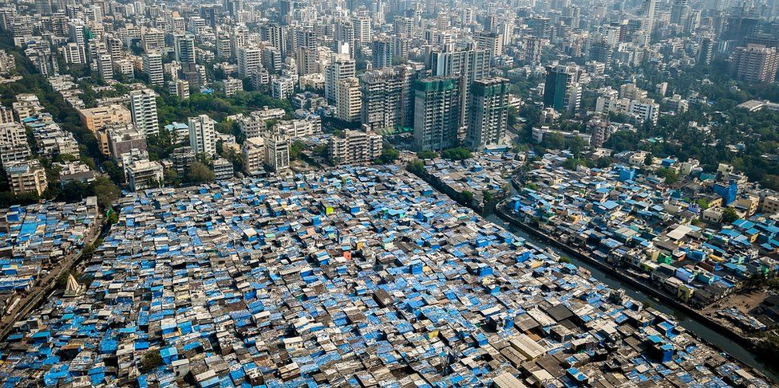
Go to the margins
“When God wanted to regenerate creation, He chose to go to the margins – to places of sin and misery, of exclusion and suffering, of illness and solitude.”
Pope Francis
Notes:
The Church was born in the margins of the crucifixion, where so many of the crucified are found…You have to go to the edges of existence if you want to see the world as it is….Page 3 of Prep Doc

Slide 13
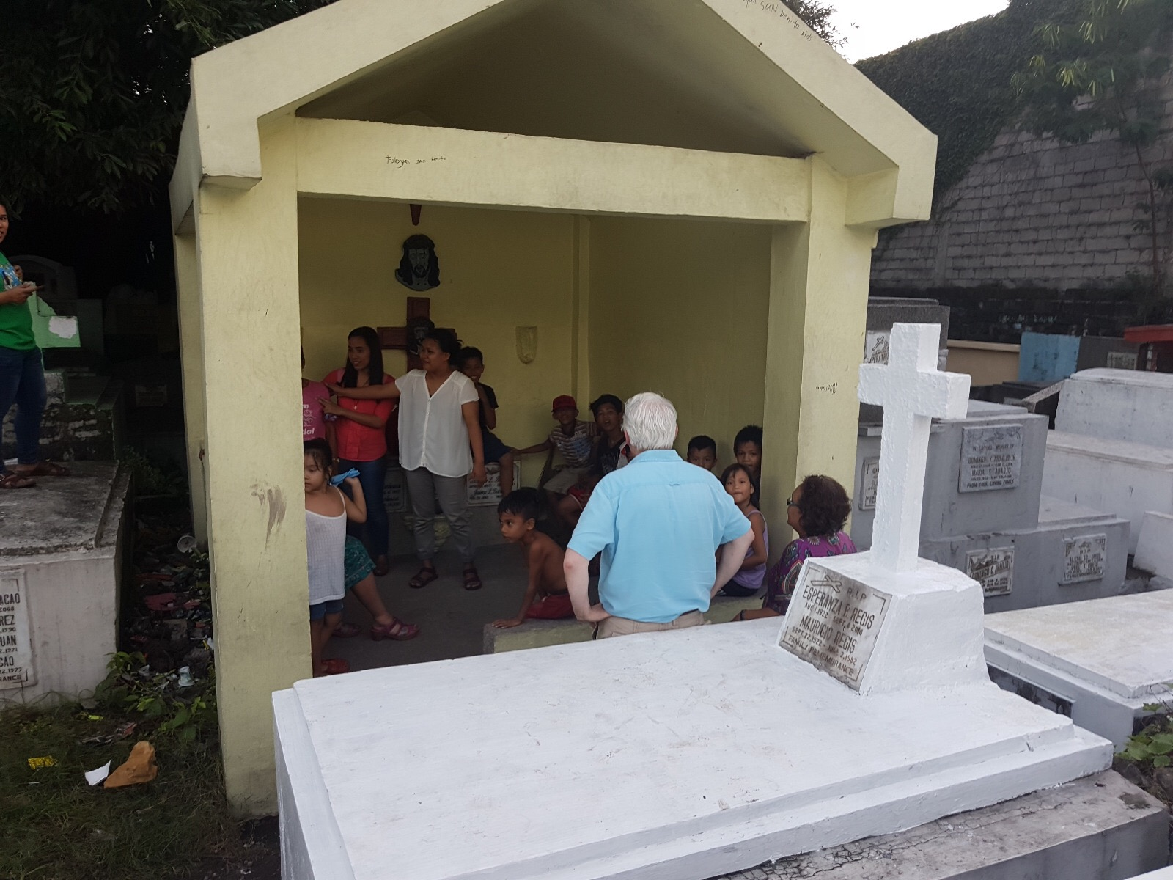
Let the oppressed go free
Notes:
Two Examples of structures of solidarity – liberation – Fatima House - Manila

Slide 14
“Church communities, brought together by the message of Jesus Christ and gathered in the Holy Spirit round the risen Lord, offer themselves as places of communion, witness and mission, and as catalysts for the redemption and transformation of social relationships.”
Compendium, 52
Notes:
Social relationships in the parish – and in the community – community development

Slide 15
The Purpose of Catholic Education
“Educating is a lot more than just instructing people…as if it were legitimized only if it served the market economy and the labour market.”
“Students need to be respected as integral persons and be helped to develop a multiplicity of skills that enrich the human person, such as creativity, imagination, the ability to take on responsibilities, to love the world, to cherish justice and compassion.”
Educating Today and Tomorrow: A Renewing Passion (Congregation for Catholic Education, 2014)
Notes:
agents of compassion and justice and change – need to be educated – to unpick the lies that maintain the systems of inequality, the power structures that maintain racial and sexual injustice….Luke 4

Slide 16
The mission of the Church
in a post-Covid society:
What does it look like
in a Catholic school?
Notes:
What steps does the Spirit invite us to take in order to grow in our “journeying together”?

Slide 17

“Christ’s Gospel summons us to display special concern for the poor and to recognize the varied and excessive forms of moral and social disorder that are generating ever new forms of poverty.”
Pope Francis
Notes:
CSAN Resources Forms of poverty – wherever humans are not flourishing, wherever fully human life is not being lived….

Slide 18
“It is undoubtedly an act of love, the work of mercy by which one’s neighbour responds here and now to a real and impelling need of one’s neighbour, but it is an equally indispensable act of love to strive to organise and structure society so that one’s neighbour will not find himself or herself in poverty…..”
Compendium, 208
Notes:
Structures of sin into structures of solidarity

Slide 19
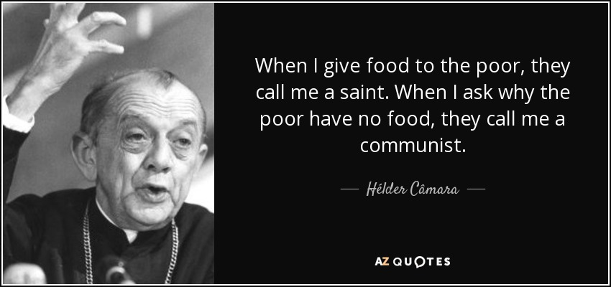

Slide 20
See
Judge
Act
Notes:
Community discernment – do you see you own parish – its relations – its structures – its inclusion, its formation, its racism or misogyny

Slide 21
Synod 2023
Ten Thematic Nuclei
The Journeying Companions – Who is in “our Church”, who is on the margins?
Listening – Who do we need to listen to? Who is excluded?
Speaking out with boldness – prophetic voice?
Celebrating – word of God and Eucharist
Co-responsible in the mission – how does community support?
Dialogue in Church and society – learn from civil society, the poor
With other Christian denominations
Authority and participation - how is authority exercised, practices?
Discerning and deciding – decision, obedience to Spirit, transparency
Forming ourselves in synodality – formed for discernment and leadership?

Slide 22

Synod 2021-23
The purpose of the Synod is “to plant dreams, draw forth prophecies and visions, allow hope to flourish, inspire trust, bind up wounds, weave together relationships, awaken a dawn of hope, learn from one another and create a bright resourcefulness that will enlighten minds, warm hearts, give strength to our hands.”
Preparatory Document

Slide 23
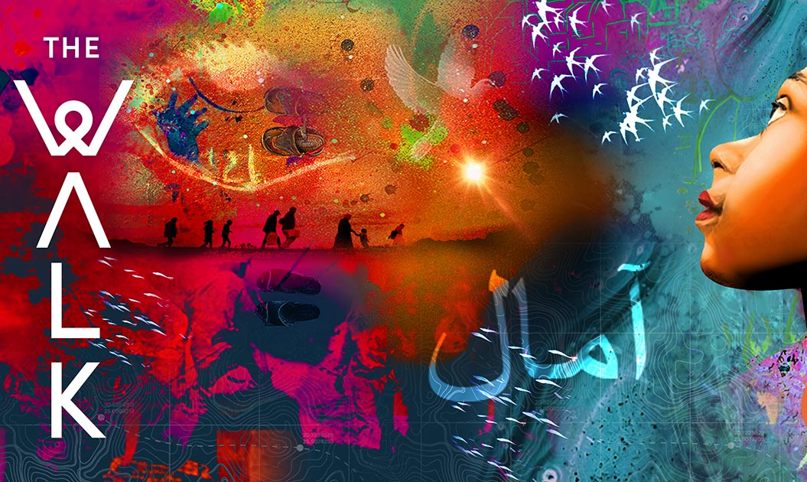
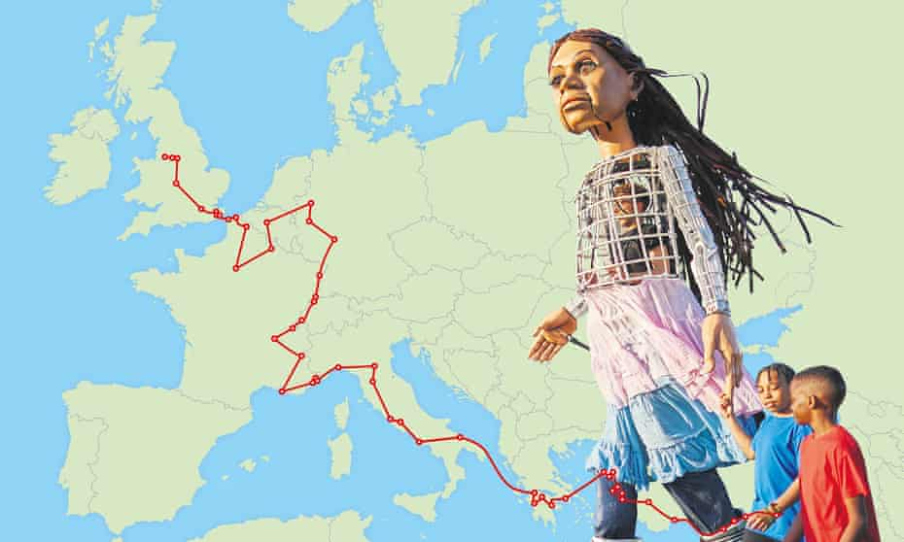
Walk with Amal
https://www.walkwithamal.org/
Notes:
Pedagogy – big questions – key concepts – home, separation, migration, authority, walls, bridges, welcome, home – Hummingbird projetc

Slide 24
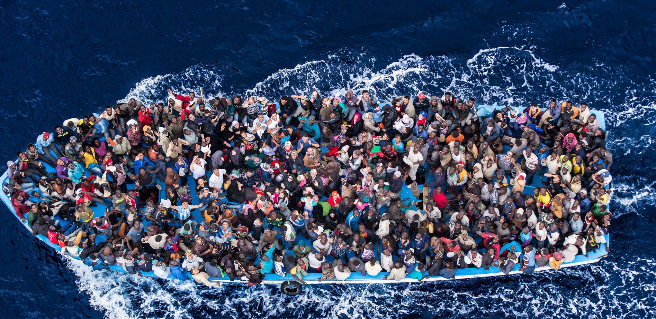
“Our response to migrating persons can be summed up in four words: welcome, protect, support, integrate.”
Pope Francis

Slide 25
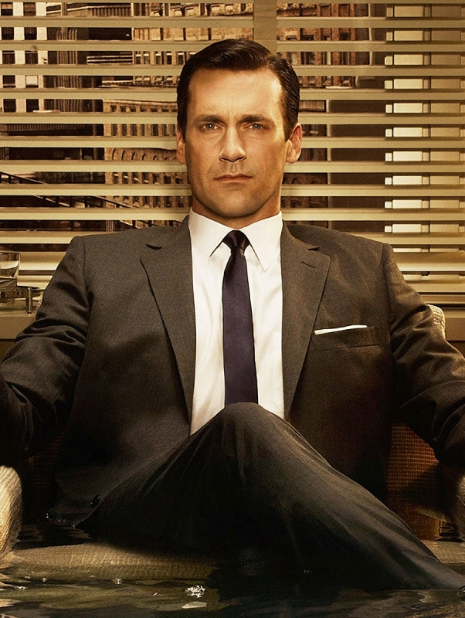
“Happiness is the smell of a new car.”
Don Draper, Mad Men
Notes:
The great acceleration….

Slide 26
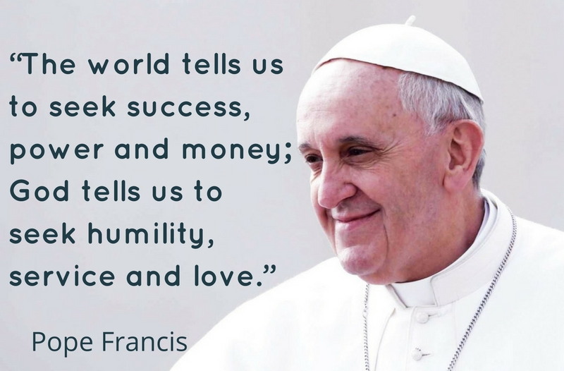

Slide 27

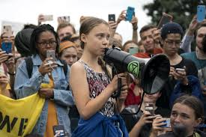
No-one is too small to make a difference
Notes:
Season of Creation – COP 26 – working with people of goodwill

Slide 28
“Men and women who are made ‘new’ by the love of God are able to change the rules and the quality of relationships, transforming even social structures. They are people capable of bringing peace where there is conflict…of seeking justice where there prevails the exploitation of man by man. Only love is capable of radically transforming the relationships that men maintain among themselves.”
Compendium, 4
Notes:
Structures of sin into structures of solidarity

Slide 29
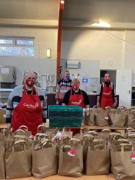
Caritas: the face of Christ
“I was hungry and you gave me food, I was thirsty and you gave me something to drink, I was a stranger and you welcomed me.”
Matthew 25: 35
Notes:
Fed the hungry….build back better…level up….love is organised….but is that enough?

Slide 30
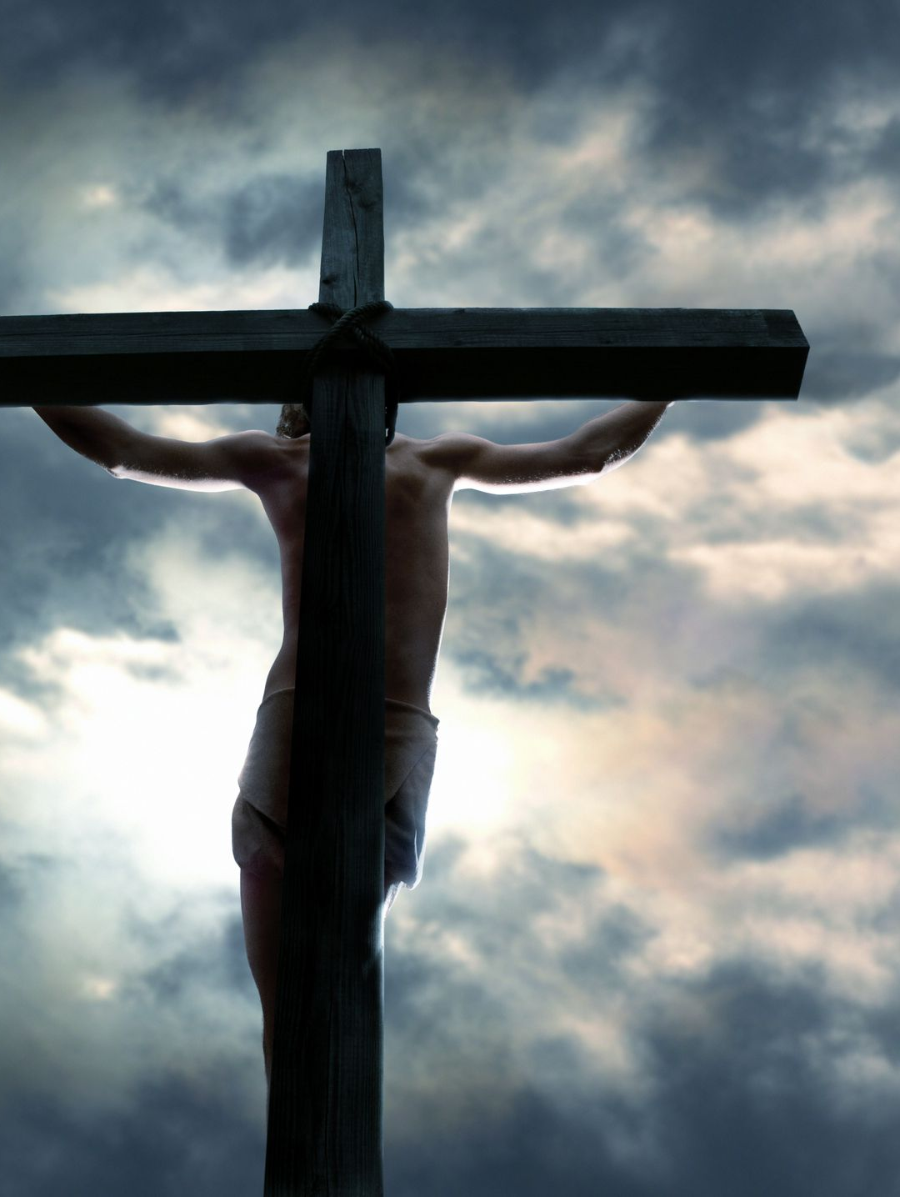
Authority and Power
“For the disciples of Jesus, yesterday, today and always, the only authority is the authority of service, the only power is the power of the cross.”
Pope Francis
Notes:
McCabe says that at crucifixion original sin is revealed as our rejection of God’s love, our desire to scapegoat the one who challenges our injustice, our relationships based on fear and domination, rivalry and violence, greed and power; at crucifixion sin of the world is simultaneously revealed and conquered, forgiven

Slide 31
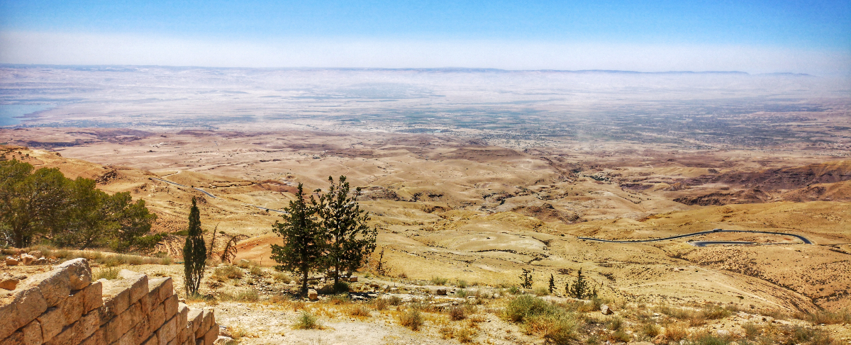
When someone deeply listens to you
Your bare feet are on the earth
And a beloved land that seemed distant
Is now at home within you
John Fox
Notes:
Listening bestows dignity…at heart of Church at this moment…Tridentine church was reactive “over against” The reformation, the secular forces of enlightenment and modernism…Vatican II the Church turned again to the modern world….listen to the word of God, the Holy Spirit at work in our world….what do you hear…

Slide 32
Being Human
“Jesus was sent to be among us, to be human. He was simply sent to be human amongst frightened humans. He was the first really human being, the first to live wholly by love, which is what being human is about. And so of course he was too dangerous to us to let him live. We got rid of him lest we should have to be human too.”
Herbert McCabe, God Still Matters
Notes:
Like us in all things but sin – to show us what being human was all about – our vocation as human beings to be loving, to serve, not to cling, or be in rivalry…from beginning of Israel, bringing to birth a new way of being human, being together…

Slide 33
Field Hospital – Tomas Halek
Diagnostic – signs of times – “the duty” (GS, 4)
Preventive – immune system against viruses of racism, populism, misogyny and fear
Convalescent – recovery from trauma through lament, forgiveness and accompaniment
https://www.americamagazine.org/faith/2020/04/03/christianity-time-sickness
Notes:
“The Church has the duty in every age of examining the signs of the times and interpreting them in the light of the gospel, so that it can offer in a manner appropriate to each generation replies to the continual human questioning of the meaning of this life and the life to come and how they are related”
Gaudium et Spes, 4
Diagnosis – since 1950s the Great Acceleration – rise in GDP, use of power transport, technology, culture of possessions, empire of money, Madison Avenue, culture of desire – with neoliberal economics of 1980s this culture was on steroids…the brutality and inequality of this culture is what has been exposed…the harassed workers, the low paid, the isolated, the neglected, culture of individualism

