Slide 1

CALLED TO BE PEACEMAKERS: EXPLORING PEACE AS A CHRISTIAN VOCATION

Slide 2
In this workshop:
  We will be exploring what peace means
  We will look at why peace is an important part of CST
  We will discuss ways to bring learning about peace and peacemaking into the classroom

Slide 3
Which statement do you agree with most?
  Peace is an action
  Peace is a feeling
  Peace is being safe
  Peace is being valued
  Peace is the absence of conflict

Slide 4
Which statement do you agree with more?
If you want peace work for justice
If you want peace prepare for war

Slide 5
Peace as part of Catholic Social Teaching
  Key principle
  Biblical basis- Old and New Testament
  Pacem in Terris
  Pope Francis
  Echoes of other definitions of peace e.g. Johan Galtung, levels of peace

Slide 6
Pax Christi and Peace Education
  Pax Christi in an international Catholic movement for peace
  We work through campaigning, solidarity, prayer and education
  People as peacemakers having the tools to build peaceful communities

Slide 7
“In recent years, there has been a significant reduction worldwide in funding for education and training; these have been seen more as expenditures than investments. Yet they are the primary means of promoting integral human development; they make individuals more free and responsible, and they are essential for the defence and promotion of peace. In a word, teaching and education are the foundations of a cohesive civil society capable of generating hope, prosperity and progress.
Military expenditures, on the other hand, have increased beyond the levels at the end of the Cold War and they seem certain to grow exorbitantly.”
Pope Francis, World Day of Peace Message 2022
What does this call us to do?
“The peacemaker, according to Jesus’ beatitude, is the one who seeks the good of the other, the fullness of good in body and soul, today and tomorrow.
From this teaching one can infer that each person and every community, whether religious, civil, educational or cultural, is called to work for peace. Peace is principally the attainment of the common good in society at its different levels, primary and intermediary, national, international and global. Precisely for this reason it can be said that the paths which lead to the attainment of the common good are also the paths that must be followed in the pursuit of peace.”
Pope Benedict XVI, World Day of Peace Message 2013

Slide 8
What can we do in the classroom?
  In RE: through the curriculum, GCSE and A-level, Core RE, saints and Bible stories
  Other lessons: Teach Peace, citizenship, PSHE, STEM, form time
  Wider school: Chaplaincy, Remembrance, peer mediation, cadets, fundraising and campaigns
  Wider community: local peacemakers, Peace Sunday

Slide 9
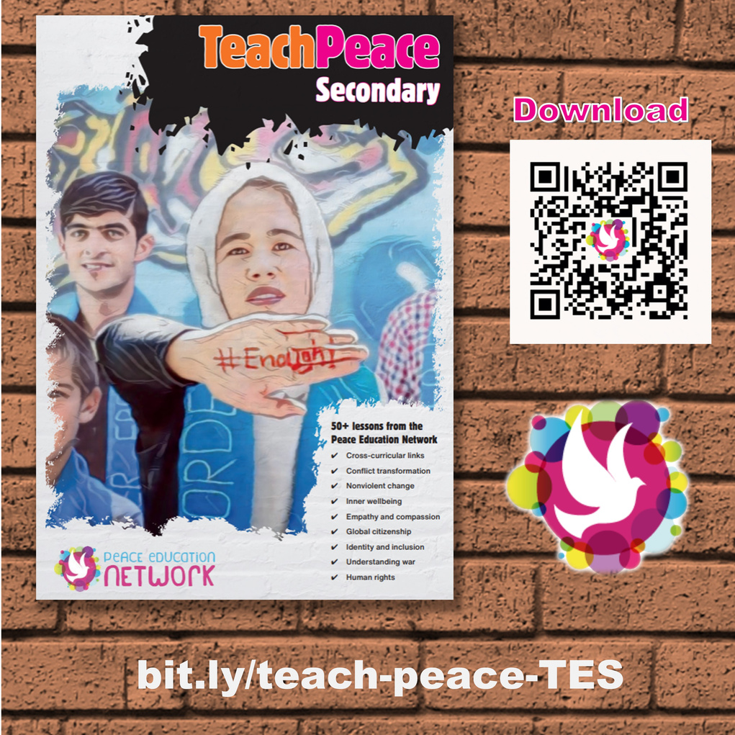
https://www.quaker.org.uk/documents/peace-at-the-heart

Slide 10




www.paxchristi.org.uk
@PaxChristiYouth
/PaxChristiYouth
@paxchristiyouth
education@paxchristi.org.uk

